Slide 1
Web Application Development
HTML Basics

Slide 2
HTML
HTML
Stands for HyperText Markup Language
HyperText
The text that has reference to another text document
Markup language
Language that is both machine and human readable
HTML Page
HTML pages are text documents containing HTML structure
HTML describes the structure of a page
HTML files are text files with extension “htm” or “html”
Notes:
HTML, as a markup language doesn't really “do” anything in the sense that a programming language does. HTML contains no programming logic.

Slide 3

HTML History
Tim Berners-Lee invented html in 1991
Version | Year
HTML | 1991
HTML 2.0 | 1995
HTML 3.2 | 1997
HTML 4.01 | 1999
XHTML | 2000
HTML5 | 2014

Slide 4
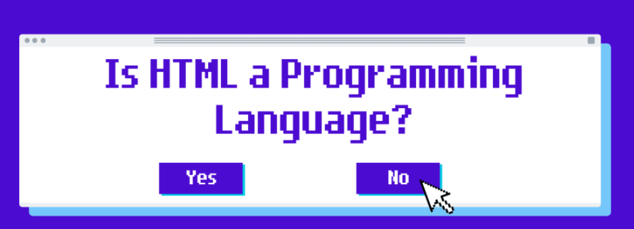
Notes:
No, HTML is not a programming language. The "M" stands for "Markup". Generally, a programming language allows you to describe some sort of process of doing something, whereas HTML is a way of adding context and structure to text.
No Logic! No Fun!
HTML can't make choices
HTML can't reuse the code
HTML is bad in maths
HTML can't modify your data
HTML can't deal with inputs and give output
HTML doesn't give any errors

Slide 5
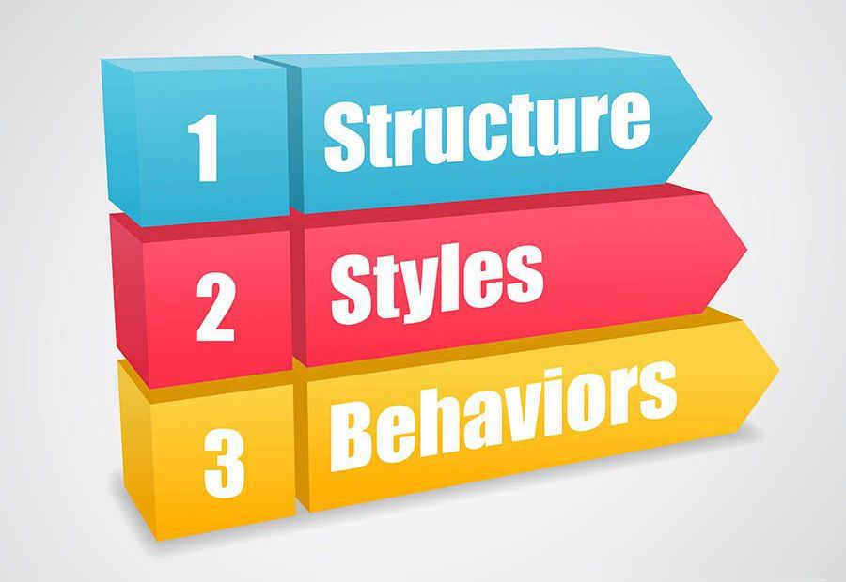
3 Layers of Web Design

Slide 6
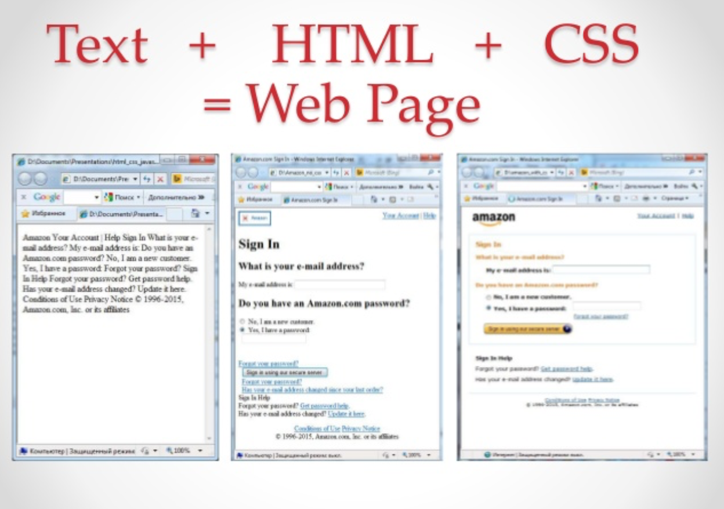

Slide 7
HTML <!DOCTYPE> Declaration
<!DOCTYPE html> <html> …
…
…
…
…
…
</html>

Slide 8
<!DOCTYPE> Definition and Use
The <!DOCTYPE> declaration must be the very first thing in your HTML document, before the <html> tag.
The <!DOCTYPE> declaration is not an HTML tag; it is an instruction to the web browser about what version of HTML the page is written in.
In HTML 4.01, the <!DOCTYPE> declaration refers to a DTD (Document Type Definition)
The DTD specifies the rules for the markup language, so that the browsers render the content correctly.
HTML5 does not require a reference to a DTD.
There are three different <!DOCTYPE> declarations in HTML 4.01.
In XHTML 1.1 and HTML5 there is only one.
Version | Year
HTML | 1991
HTML 2.0 | 1995
HTML 3.2 | 1997
HTML 4.01 | 1999
XHTML | 2000
HTML 5 | 2014
Notes:
DTD (Document Type Definition).

Slide 9
<!DOCTYPE> Usage
Always add the <!DOCTYPE> declaration to your HTML documents, so that the browser knows what type of document to expect.
The <!DOCTYPE> declaration is NOT case sensitive
HTML 4.01 doctypes are:
Strict
Tranditional
Frameset

Slide 10
Common DOCTYPE Declarations
HTML 5
<!DOCTYPE html>
HTML 4.01 Strict
<!DOCTYPE HTML PUBLIC "-//W3C//DTD HTML 4.01//EN" "http://www.w3.org/TR/html4/strict.dtd">
HTML 4.01 Transitional
<!DOCTYPE HTML PUBLIC "-//W3C//DTD HTML 4.01 Transitional//EN" "http://www.w3.org/TR/html4/loose.dtd">
HTML 4.01 Frameset
<!DOCTYPE HTML PUBLIC "-//W3C//DTD HTML 4.01 Frameset//EN" "http://www.w3.org/TR/html4/frameset.dtd">
XHTML 1.1
<!DOCTYPE html PUBLIC "-//W3C//DTD XHTML 1.1//EN" "http://www.w3.org/TR/xhtml11/DTD/xhtml11.dtd">

Slide 11
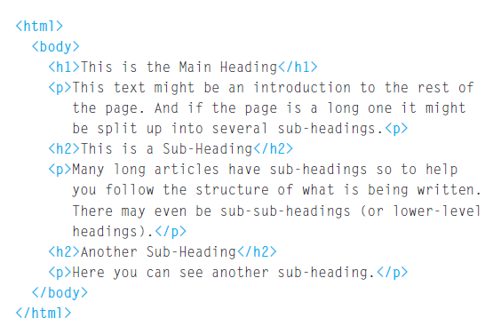
Example: HTML Structure

Slide 12
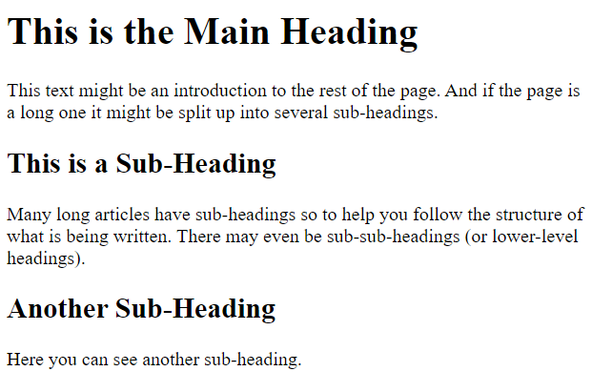
Example: HTML Structure

Slide 13
HTML Structure
The opening <html> tag indicates that anything between it and a closing </html> tag is HTML code.

Slide 14
HTML Structure
The <body> tag indicates that anything between it and the closing
</body> tag should be shown inside the main browser window.

Slide 15
HTML Structure
Words between <h1> and </h1> are a main heading.

Slide 16
HTML Structure
Words between <h1> and </h1> are a main heading.

Slide 17
HTML Structure
paragraph of text appears between these <p> and </p> tags.

Slide 18
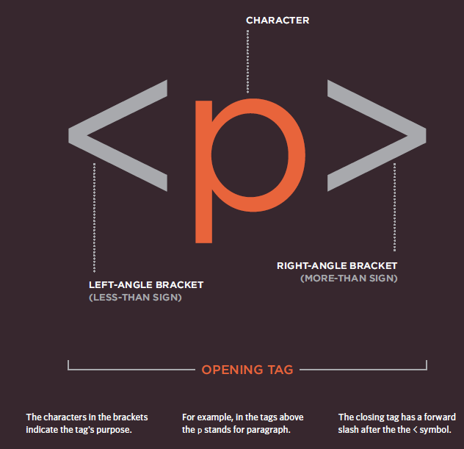
HTML Tags

Slide 19
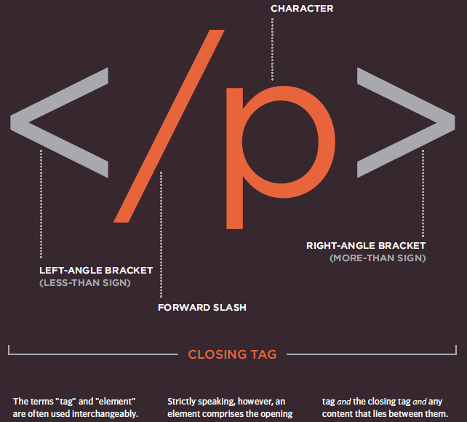
HTML Tags

Slide 20
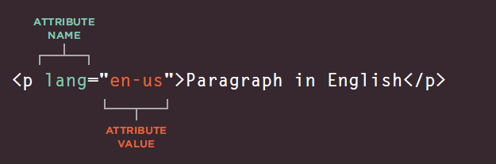
Attributes
Attributes Tell Us More About Elements
Attributes provide additional information about the contents of an element. They appear on the opening tag of the element and are made up of two parts: a name and a value, separated by an equals sign.

Slide 21
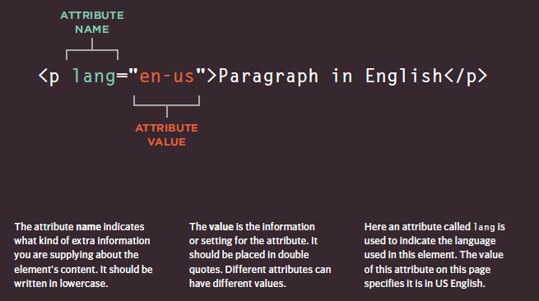
HTML Tags
Attributes Tell Us More About Elements

Slide 22
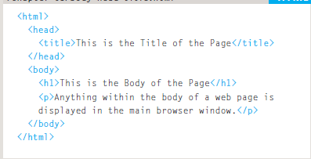
Body & Title
Everything inside body element is
shown inside the main browser window.

Slide 23
Body & Title
This contains information that are shown on top of the page

Slide 24
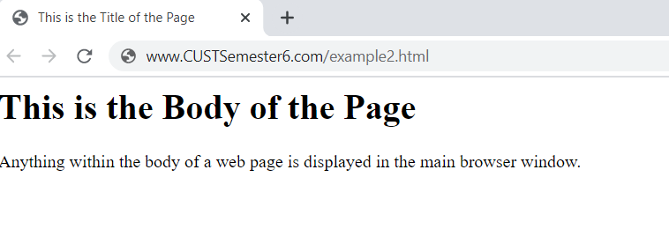
Body & Title

Slide 25
Headings
HTML has six "levels" of headings:
<h1> is used for main headings
<h2> is used for subheadings
If there are further sections under the subheadings then the <h3> element is used, and so on...

Slide 26
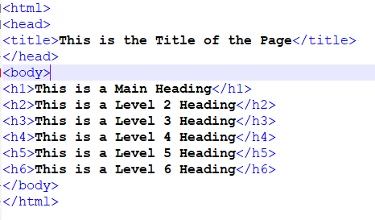
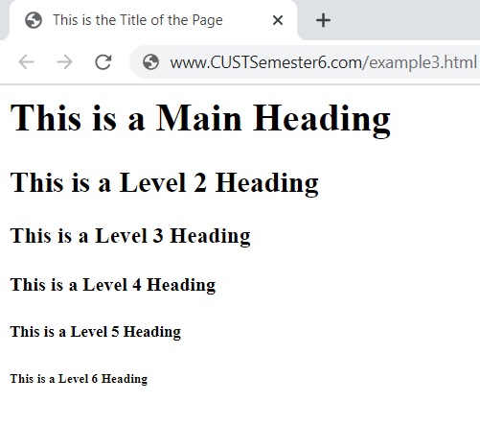
Heading
Example code

Slide 27
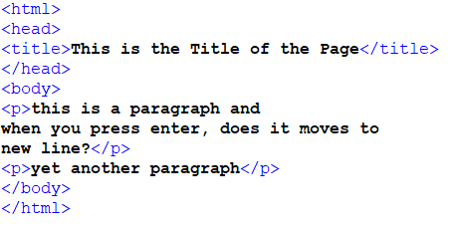
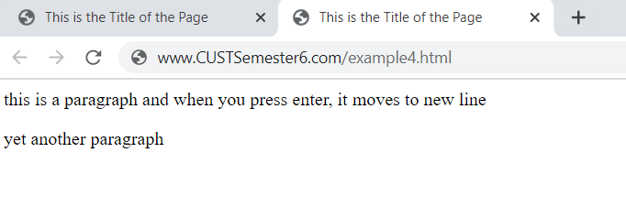
Paragraph
A paragraph consists of one or more sentences that form a kind of dialogue.

Slide 28
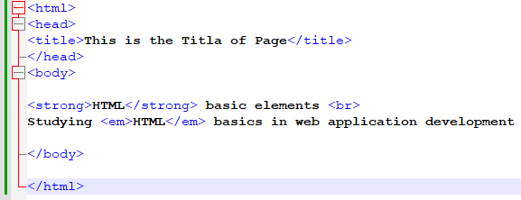
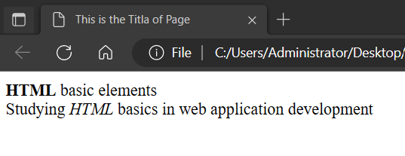
Strong and Emphasize
Strong
By enclosing words in the tags <strong> and </strong> we can make characters appear bold.
Emphasize
By enclosing words in the tags <em> and </em> we can make characters appear italic.
Example

Slide 29
Line Breaks & Horizontal Rules
Line Break
Just like <p></p> the line break <br /> breaks line and starts new line
Example
<p>The Earth<br />gets one hundred tons heavier
every day<br />due to falling space dust.</p>
Horizontal Rule
Just like <br /> it separates lines by placing a solid line in between paragraphs
<p>Venus is the only planet that rotates
clockwise.</p>
<hr />
<p>Jupiter is bigger than all the other planets
combined.</p>

Slide 30
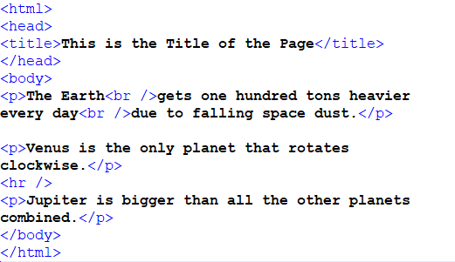
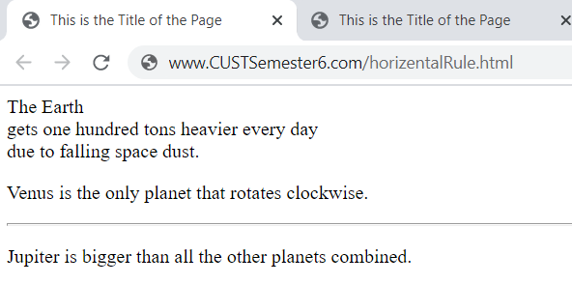
Line Breaks & Horizontal Rules

Slide 31
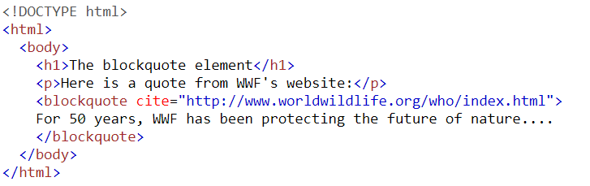
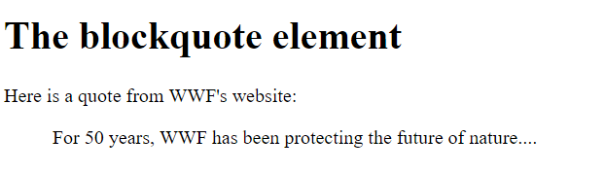
Blockquote
Blockquote
The <blockquote> tag specifies a section that is quoted from another source.
Browsers usually indent <blockquote> elements.

Slide 32
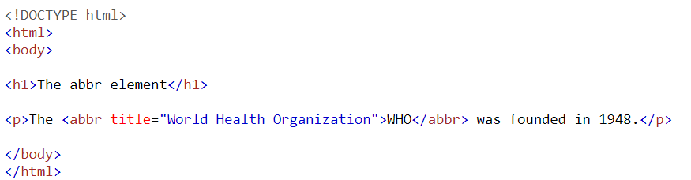
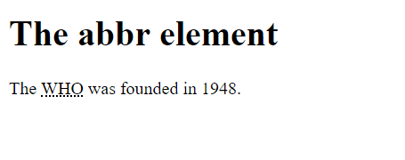
Abbreviation or Acronym
Abbreviation or an acronym
Use an abbreviation or an acronym, when you like to add shortened versions of something else

Slide 33
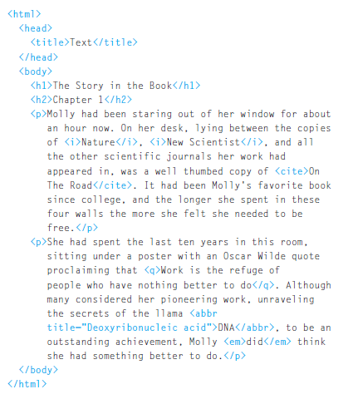
Example HTML Document

Slide 34
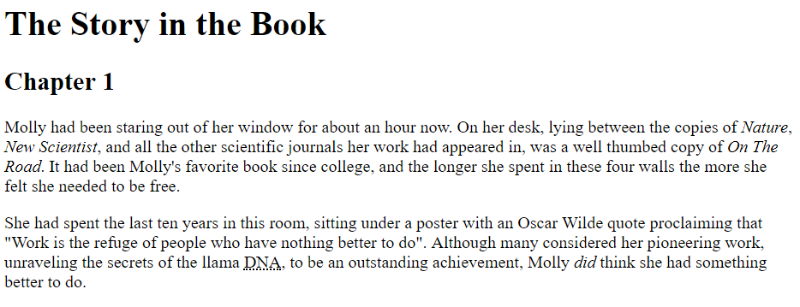
Example HTML Page

Slide 35
Lists
HTML provides us with three different types:
Ordered lists
are lists where each item in the list is numbered.
Unordered lists
are lists that begin with a bullet point (rather than characters that indicate order).
Definition lists
are made up of a set of terms along with the definitions for each of those terms.

Slide 36
List
Ordered List
<ol>
The ordered list is created with the <ol> element.
<ul>
The unordered list is created with <ul> element.
<li>
Each item in the list is placed between an opening <li> tag
and a closing </li> tag. (The li stands for list item.)
Browsers indent lists by default.

Slide 37
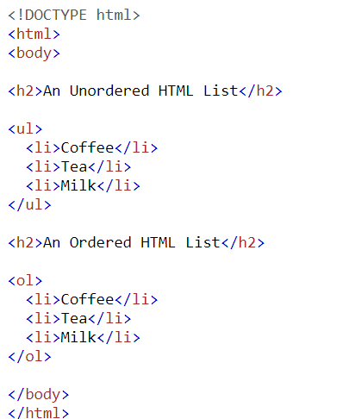
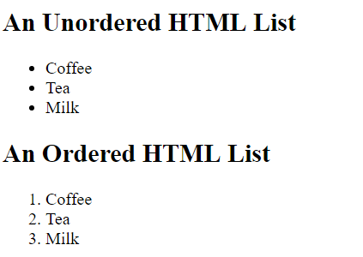
List
Example

Slide 38
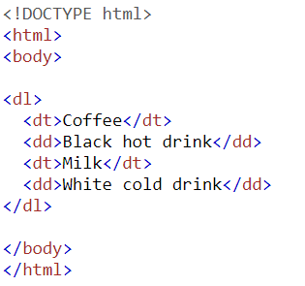
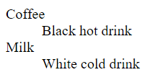
List
Definition List
The definition list is created with the <dl> element and usually consists of a series of terms and their definitions.

Slide 39
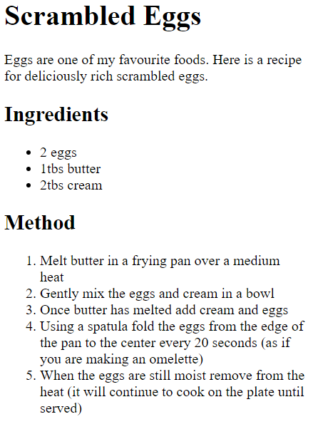
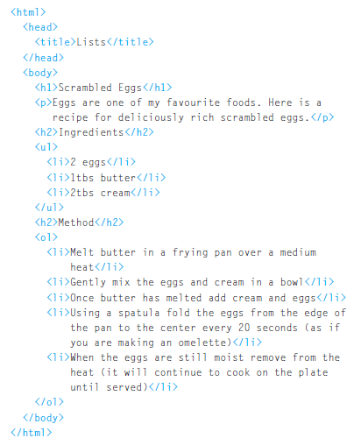
Example HTML document
Summary

Slide 40
Link
Hyperlink
A hyperlink is a word, phrase, or image that you can click on to jump to a new document or a new section within the current document.
Example
<a href="url">link text</a>

Slide 41
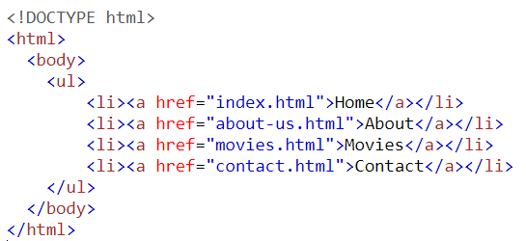
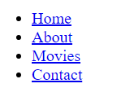
Hyperlink
Example

Slide 42
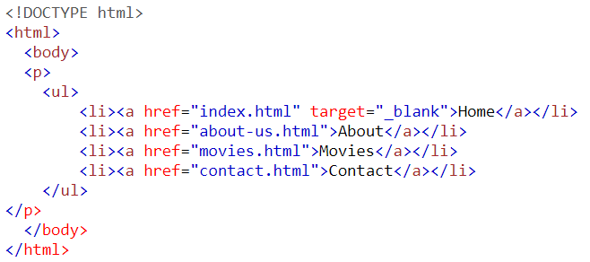
Hyperlink
Opening link in new window
Open link in new page by using target=“_blank”

Slide 43
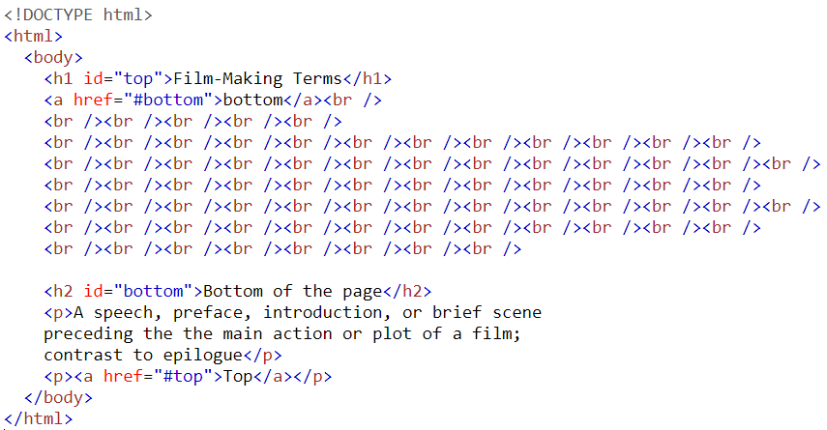
Hyperlink
Linking to a Specific Part of the Same Page

Slide 44
Hyperlink
Linking to a Specific Part of the another Page
If you want to link to a specific part of a different page (whether on your own site or a different website) you can use a similar technique.

Slide 45
Images
There are three rules to remember when you are creating images.
Save images in the right format
Save images at the right size
Use the correct resolution

Slide 46
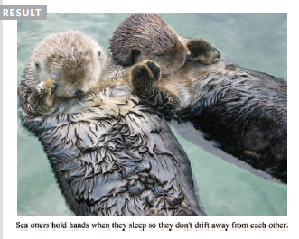
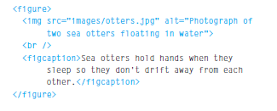
Figure & Figure Caption
<figure> element to contain images
The <img> element is used to add images to a web page
<figcaption> allow web page authors to add a caption to an image.

Slide 47
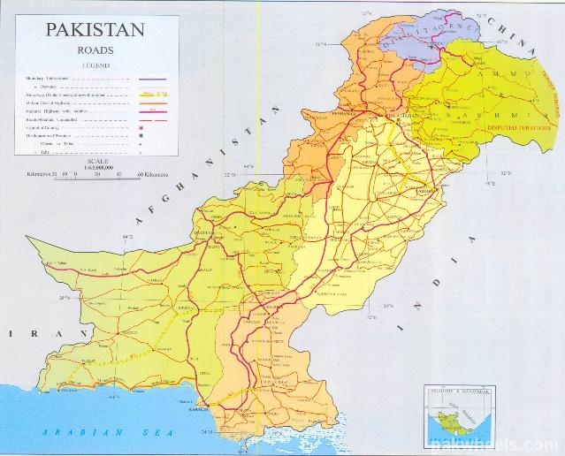
Image – alt attribute
<img src=“pk.jpg“ width=“639" height=“516“ alt=“Pakistan Map” />

Slide 48
Relative Paths
A relative URL indicates where the resource is in relation to the current page.
Same Directory contact.html
Subdirectory
arts/index.html
entertainment/arts/index.html
./images/src.jpg
Parent Directory
../index.html
../../src.jpg
From the Root /contact.html

Slide 49
Absolute Paths
A absolute URL indicates a complete path to resource.
Example
F:\Work\web\Spring-2022\logo.jpg
http://www.cust.edu.pk/image.jpg

Slide 50
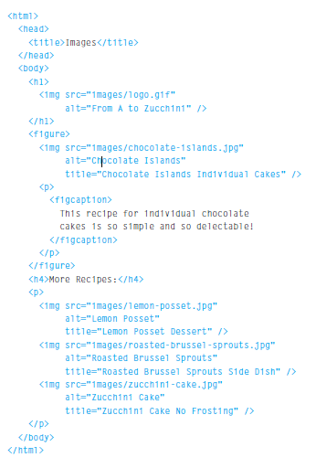

Images

Slide 51
Tables
A table represents information in a grid format.
Table
The <table> element is used to create a table. The contents of the table are written out row by row.
Row
start of each row using the opening <tr> tag and </tr> closing tag
Cell
Each cell of a table is represented using a <td> element with </td> closing tag

Slide 52
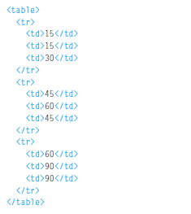
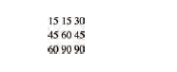
Tables

Slide 53
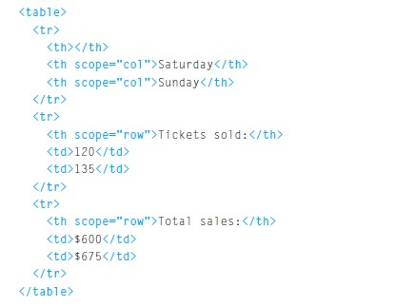
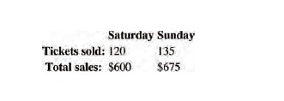
Tables

Slide 54
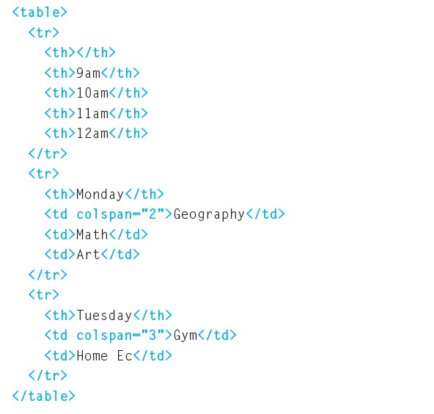
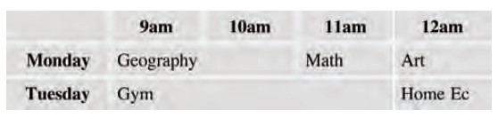
Tables

Slide 55
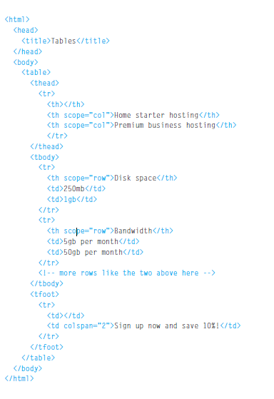
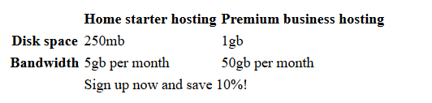
Tables

Slide 56
HTML Forms
Whenever you want to collect information from visitors you will need a form, which lives inside a <form> element.
Information from a form is sent in name/value pairs.
Each form control is given a name, and the text the user types in or the values of the options they select are sent to the server.

Slide 57
HTML Form Structure
<form>
This element should always carry the action attribute and will usually have a method and id attribute too.
Action
Every <form> element requires an action attribute. Its value is the URL for the page on the server that will receive the information.
Method
Forms can be sent using one of two methods: get or post.

Slide 58
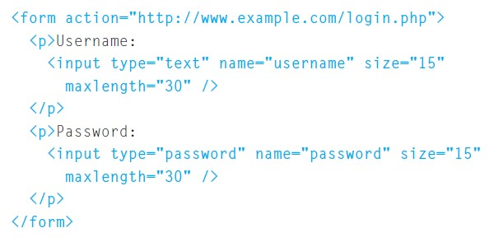
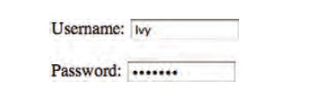
HTML FORMS
What does it means (type=“password”)

Slide 59
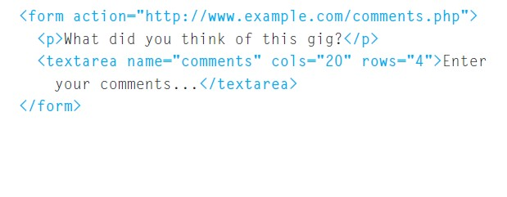



HTML FORMS
What happens if you repeat same name in radio control???

Slide 60




HTML FORMS

Slide 61


Grouping Form Elements
You can group related form controls together inside the <fieldset> element
The <legend> element can come directly after the opening <fieldset> tag and contains a caption which helps identify the purpose of that group of form
controls.

Slide 62



HTML Form Example

Slide 63
HTML Page
HTML page can be created on multiple text editor including:
Notepad
Notepad ++
Sublime
Visual Studio
Much more…

Slide 64

HTML Page – Visual Studio

Slide 65

HTML Page – Visual Studio

Slide 66

HTML Page – Visual Studio

Slide 67

HTML Page – Visual Studio

Slide 68

HTML Page – Visual Studio

Slide 69

HTML Page – Visual Studio

Slide 70

HTML Page – Visual Studio

Slide 71

HTML Page – Visual Studio

Slide 72

HTML Page – Visual Studio

Slide 73


HTML Page – Visual Studio

Slide 74

Markup Validation Service

Slide 75

Markup Validation Service

Slide 76

Markup Validation Service

Slide 77

HTML Text formatting Tags

Slide 78
HTML Entities
Result | Description | Entity Name | Entity Number
 | non-breaking space | &nbsp; | &#160;
< | less than | &lt; | &#60;
> | greater than | &gt; | &#62;
& | ampersand | &amp; | &#38;
¢ | cent | &cent; | &#162;
£ | pound | &pound; | &#163;
¥ | yen | &yen; | &#165;
€ | euro | &euro; | &#8364;
© | copyright | &copy; | &#169;
® | registered trademark | &reg; | &#174;

Slide 79
HTML Entities - Usage
Some characters are reserved in HTML.
If you use the less than (<) or greater than (>) signs in your text, the browser might mix them with tags.
Character entities are used to display reserved characters in HTML.
A character entity looks like this:
&entity_name; OR
&#entity_number;

Slide 80
HTML Entities – Math symbols
More: http://www.w3schools.com/html/html_symbols.asp
Result | Description | Entity Name | Entity Number
∀ | FOR ALL | &forall; | &#8704;
∂ | PARTIAL DIFFERENTIAL | &part; | &#8706;
∃ | THERE EXISTS | &exist; | &#8707;
∅ | EMPTY SETS | &empty; | &#8709;
∇ | NABLA | &nabla; | &#8711;
∈ | ELEMENT OF | &isin; | &#8712;
∉ | NOT AN ELEMENT OF | &notin; | &#8713;
∋ | CONTAINS AS MEMBER | &ni; | &#8715;
∏ | N-ARY PRODUCT | &prod; | &#8719;
∑ | N-ARY SUMMATION | &sum; | &#8721;

Slide 81
iframe Tag
An iframe is used to display a web page within a web page.
Syntax
<iframe src="URL"></iframe>
Iframe - Set Height and Width
<iframe src="demo_iframe.htm" width="200" height="200"></iframe>
Iframe can be used to embed video in web page.
Example: Embed following code in your HTML page
<iframe src="https://www.youtube.com/embed/x7zE7Fu8Dmw" width="454" height="280” ></iframe>

